Slide 1







keyla.ng
KEYLA TECHNOLOGIES
COMPANY PROFILE

Slide 2
About Us
Keyla Technologies is a technology company that provides technology services like website development, mobile application development, AI solutions, IT consultation, and lots more. We are focused on delivering quality services to our customers at all time, in order to provide customer satisfaction and increase overall business efficiency.
We understand the need for digitizing business processes, and how best to implement it. Therefore, we don't just build your tech solution, we build it with the best and latest technology or approach, making sure it is standard, and at the same time it is user friendly.
We do this by ensuring we have the right team, and the right business structure. Which create an enabling environment for maximum productivity.

Slide 3
Our Expertise
Website Development
Mobile App Development
AI Solutions
IT Consultation
UI/UX & Graphics Design
Blockchain Technology
IOT
Cloud Services
E-Business Services
Payment Solutions
IOS, Android, Windows
Financial technology, Banking
Payment Solutions
E-commerce
Agri-tech
Blockchain
Blog
CRM software
IOT
ERP softwares
Database design & administration
Health Tech
Edu-tech
USSD
PHP
MySQL, MySQLi, MongoDB, FireBase.
ASP.net
Javascript, Node, React.js, Vue.js
Python
Java, Kotlin, Dart.
Android Studio, Flutter, React Native

Slide 4













Our partners/clients
Past & Present
View some of our portfolio below

Slide 5
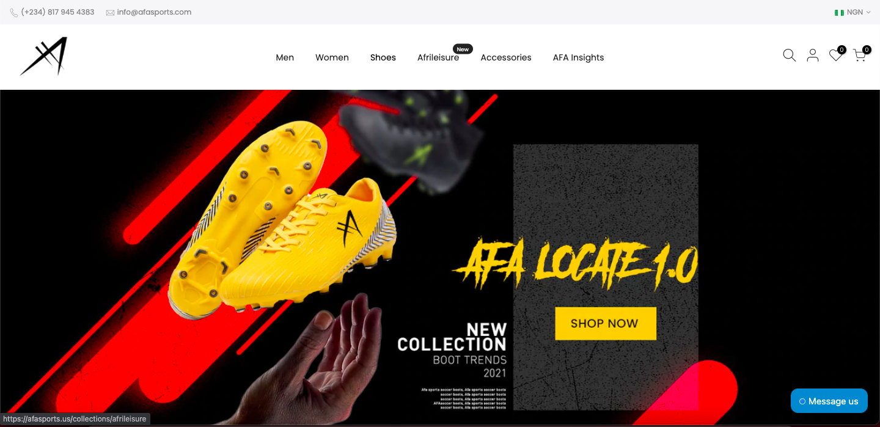

Slide 6
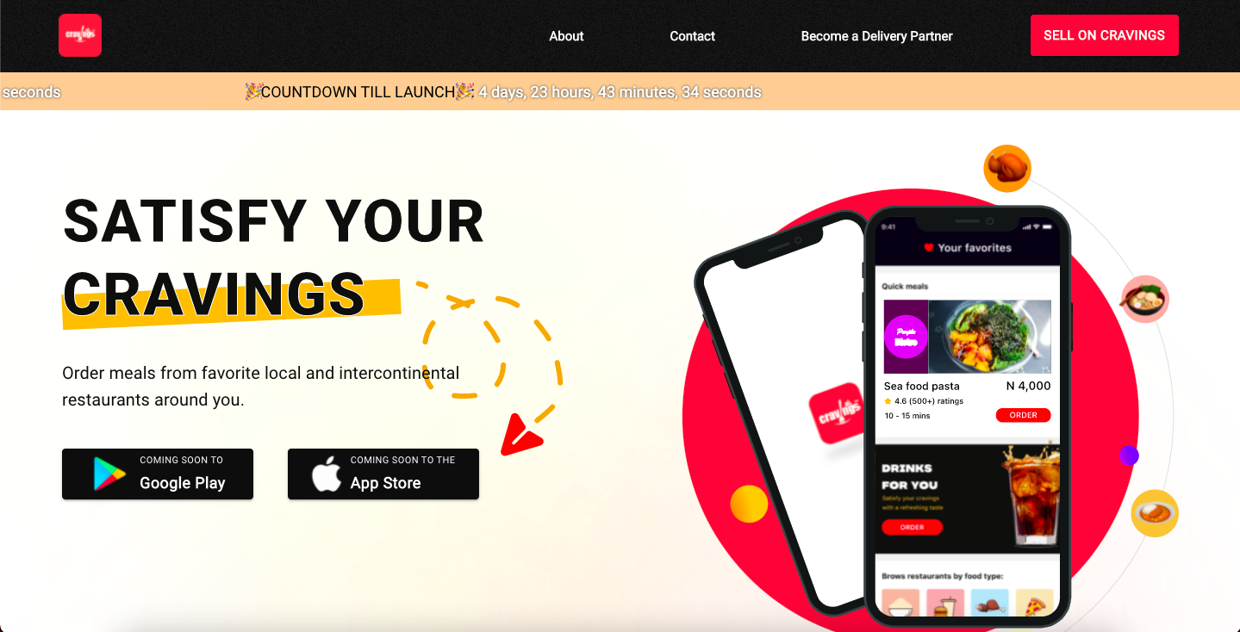

Slide 7
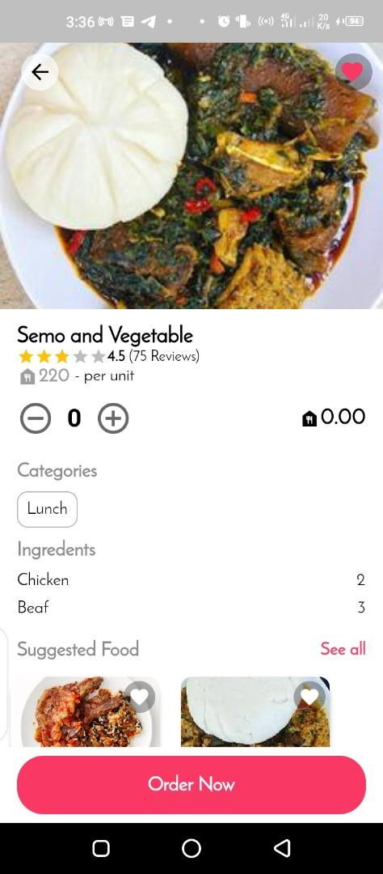
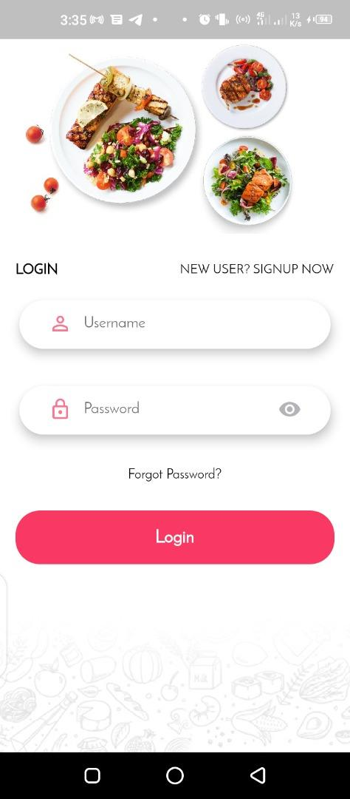
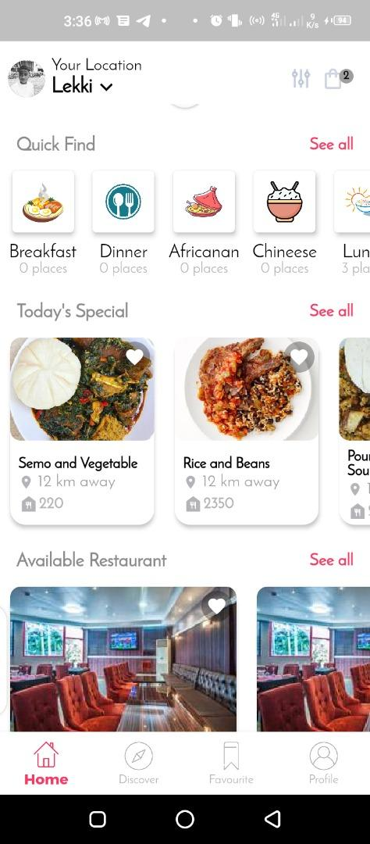


Slide 8
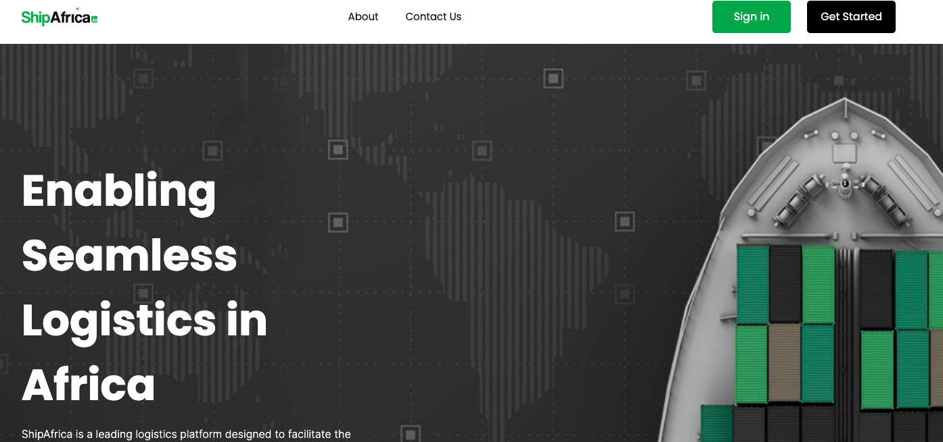

Slide 9
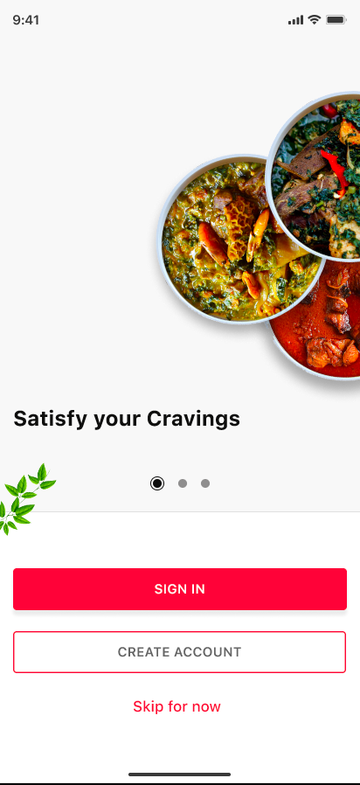
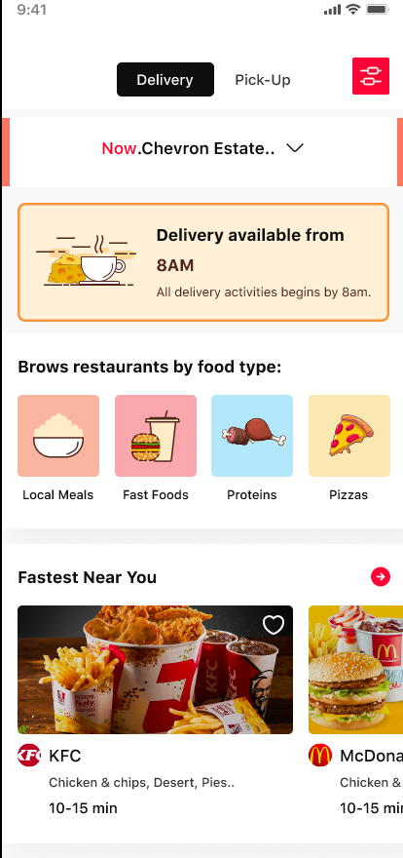
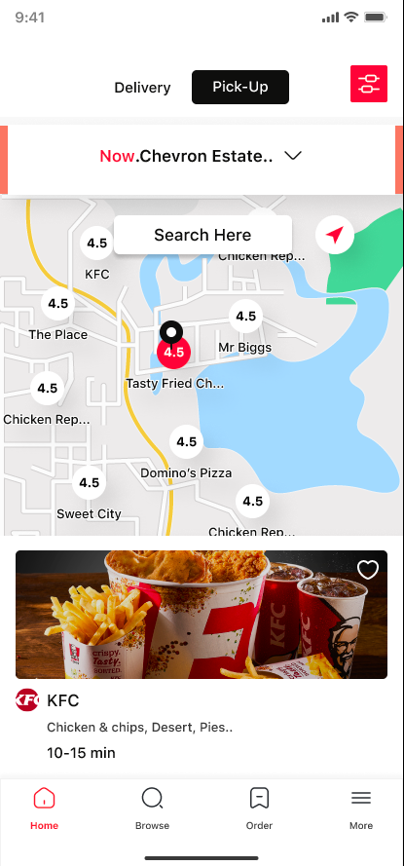
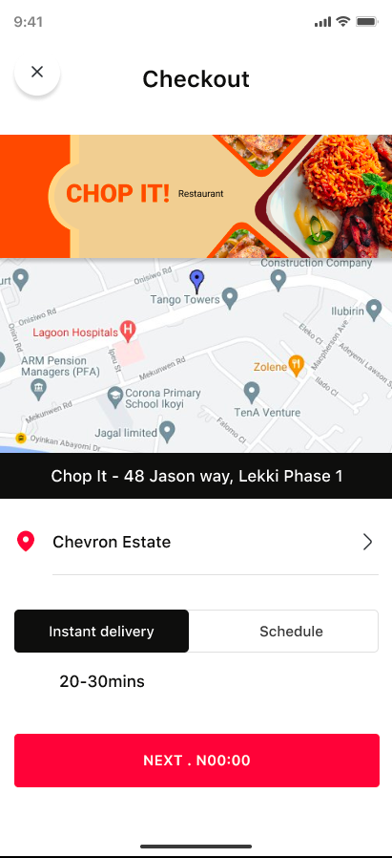

Slide 10
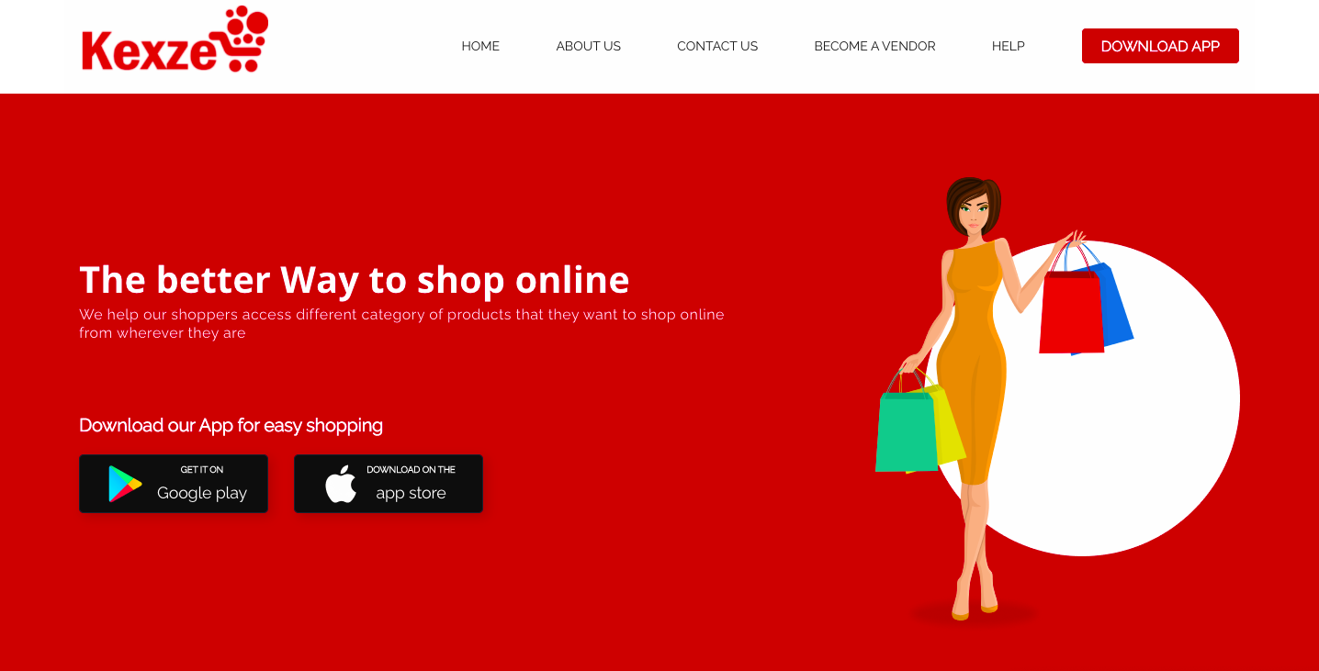

Slide 11
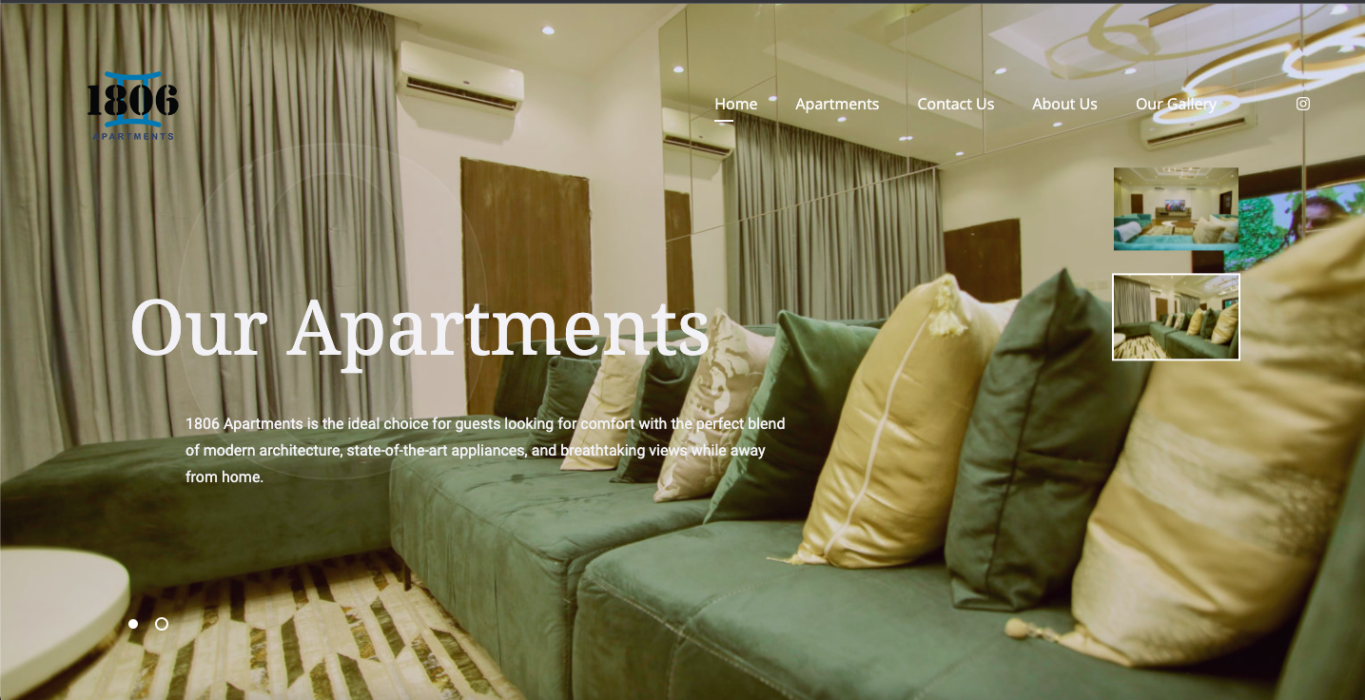

Slide 12
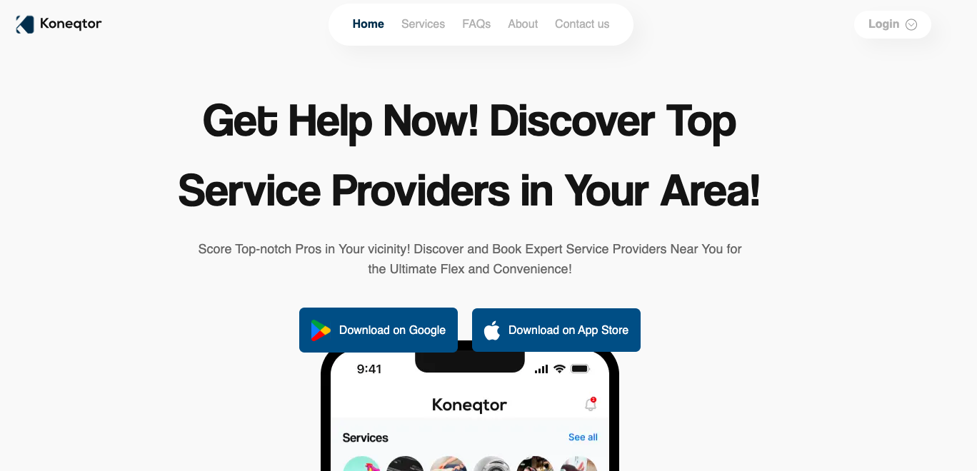

Slide 13
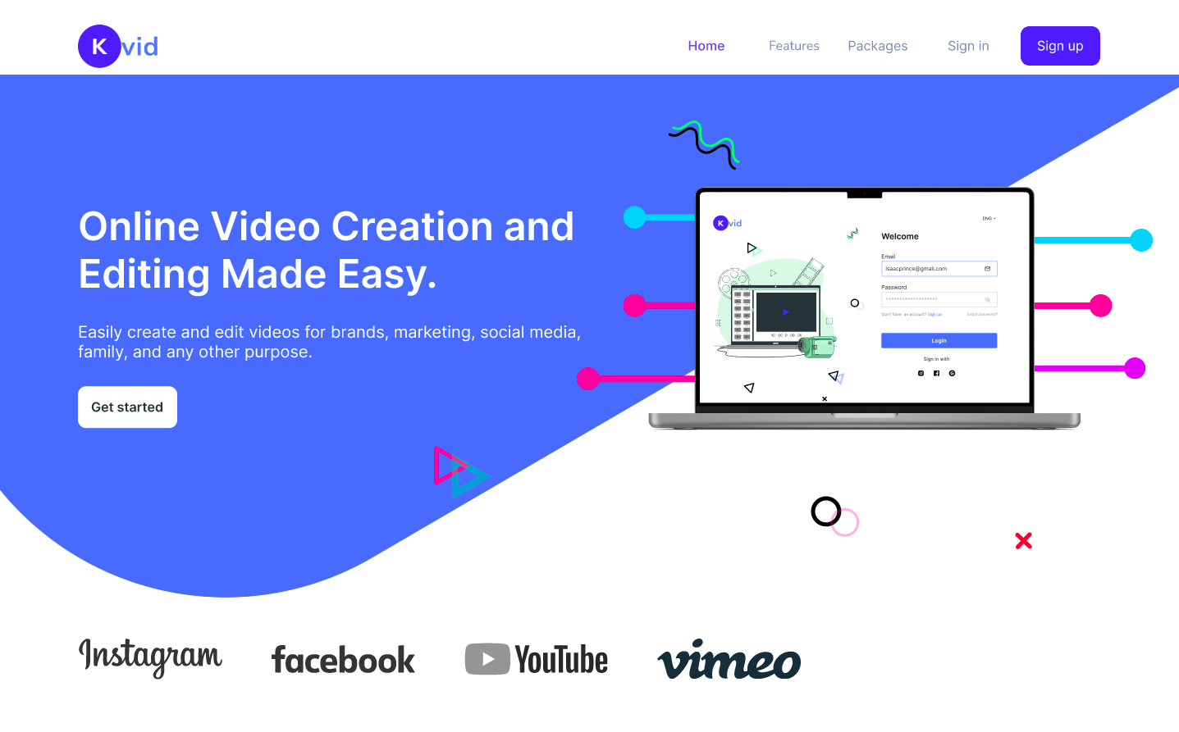

Slide 14
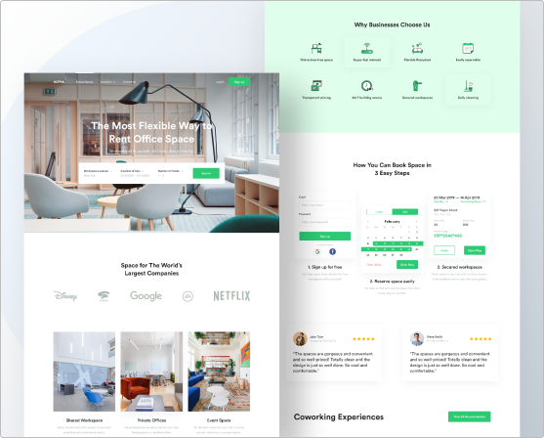

Slide 15



Slide 16

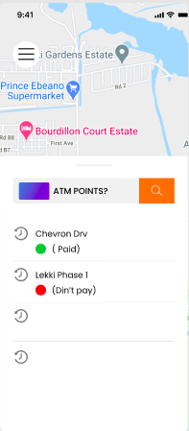
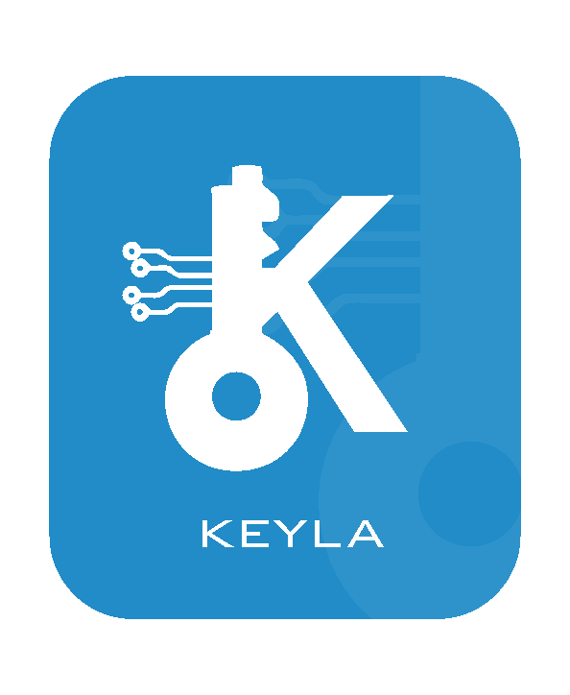

Slide 17
Thank You
Contact Us:
Email: info@keyla.ng
Mobile: +234 816 541 7645
+234 807 266 2804
Address: 2nd floor Kings Deck Building, Alter- native Route, Off Lekki, Chevron Drive, Aja Lagos.

